Slide 1
Generative AI for Efficient, Secure, and Adaptive Wireless Communications
Huacheng Zeng
Department of Computer Science and Engineering
Michigan State University
February 27, 2025

Slide 2

Our Expertise
Communication systems
  5G Cellular, Wi-Fi, LoRa, Bluetooth, and ad hoc networks
Methodologies
  Algorithm and protocol design: model-based and learning-based
  Signal processing
  System-level evaluation and validation
  Cross-layer optimization
  Leverage recent advances in AI (deep learning, online learning) technologies
Objectives
  Improve performance: spectrum efficiency, energy efficiency, etc.
  Improve security and resilience in challenging environments: anti-jamming, anti-eavesdropping, etc.)
  Improve the system usability, adaptability, intelligence while reducing cost
Notes:
Our team has intensive experience with the design and implementation of wireless communication systems, from the applications to the physical layer.

Slide 3
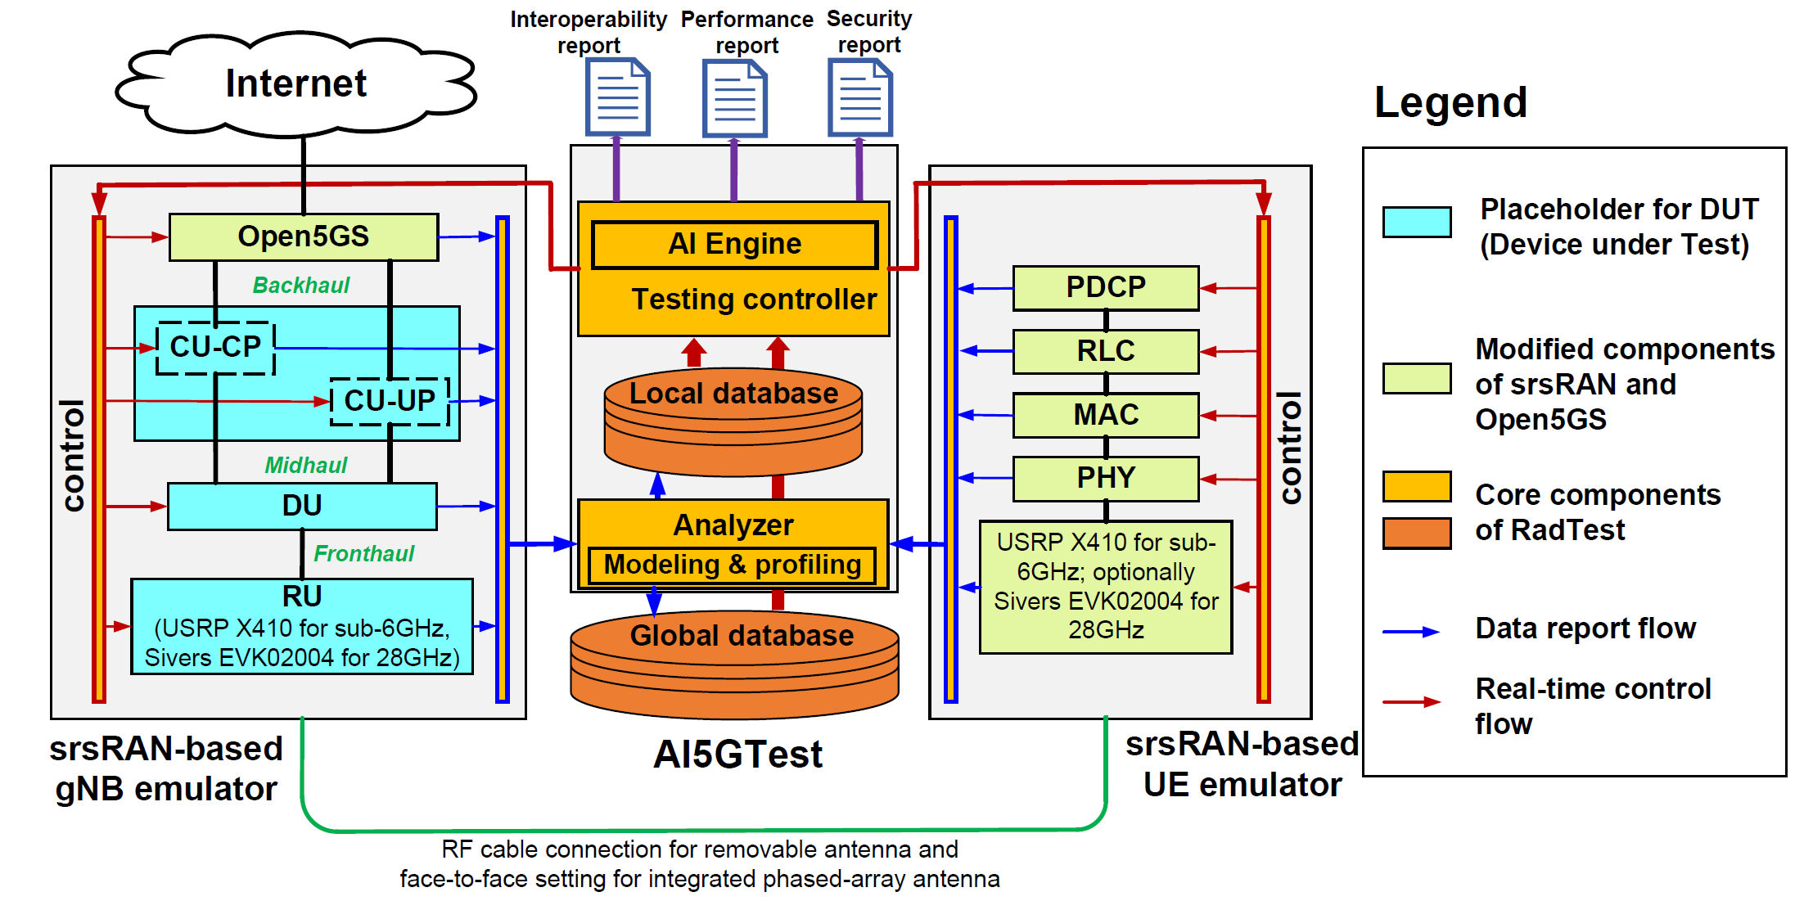
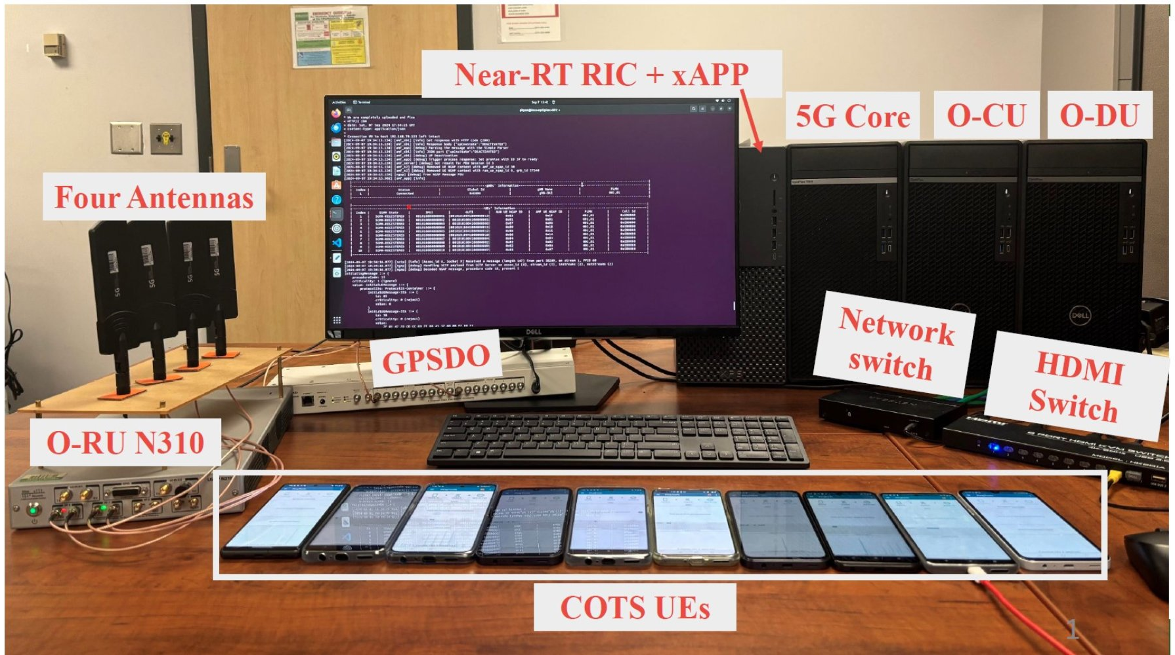
Research Highlight: AI for 5G Test
AI-Enabled Efficient Testing and Evaluation for RU, DU and CU Components of 5G Radio Access Networks
  Sponsor: NTIA NOFO 1
  Key component: use AI to enable testing automation
Our innovation: Use LLM, diffusion model, reinforcement learning for 5G testing automation
Our 5G cellular network: 3 gNB and 20 cellphones

Slide 4
END-GEN Program
Generative AI for waveform generation
  Use diffusion model to generate the waveform
  Use LLM to control the waveform generation
  Use NVIDIA's Aerial Omniverse Digital Twin to simulate and analyze real-world wireless communication environments

Slide 5
Thank you!

